Slide 1
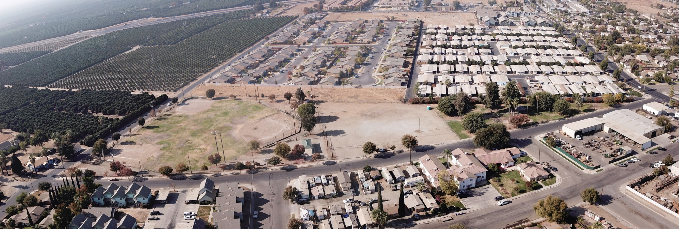
OLIVE BOWL/KAKU PARK RENOVATION PROJECT UPDATE

Slide 2
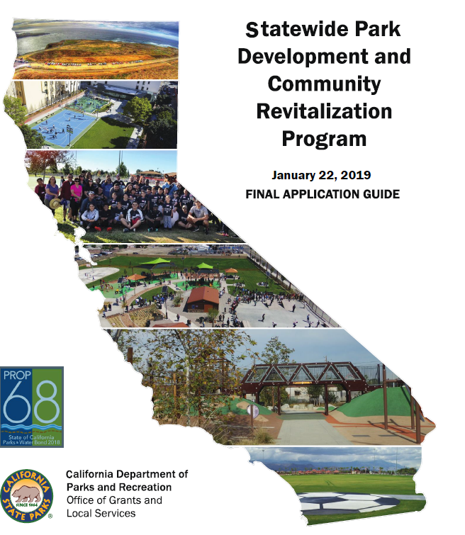
Funding & Timeline
2019 Planning & Application
February 2020 Received the Award of $3,670,437
July 2020 RFP Issued
January 26, 2021 Awarded Contract to MIG, Inc for $235,580

Slide 3
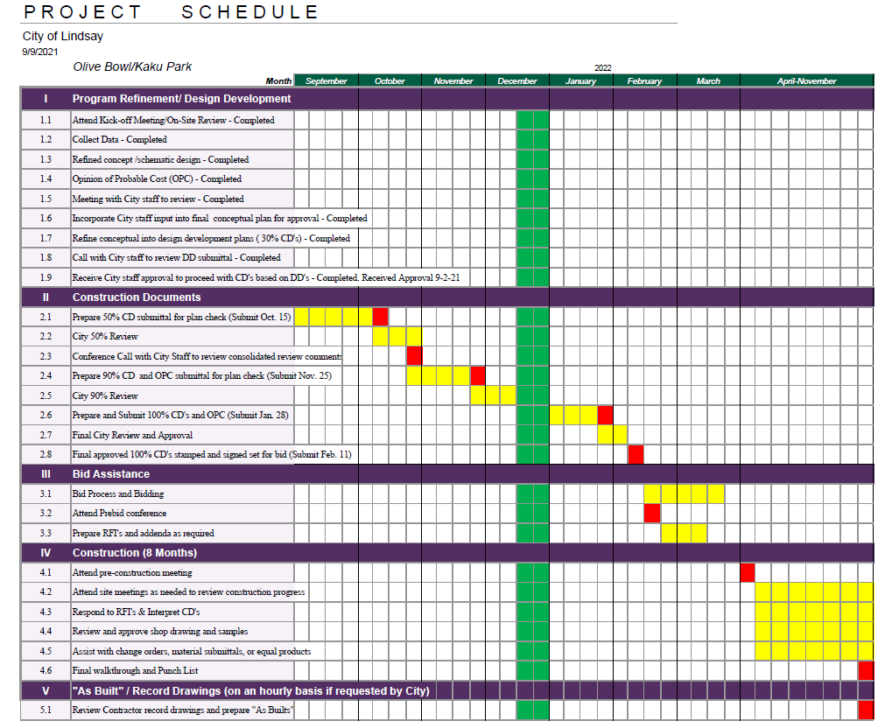
State Required Completion Date: June 30, 2024

Slide 4
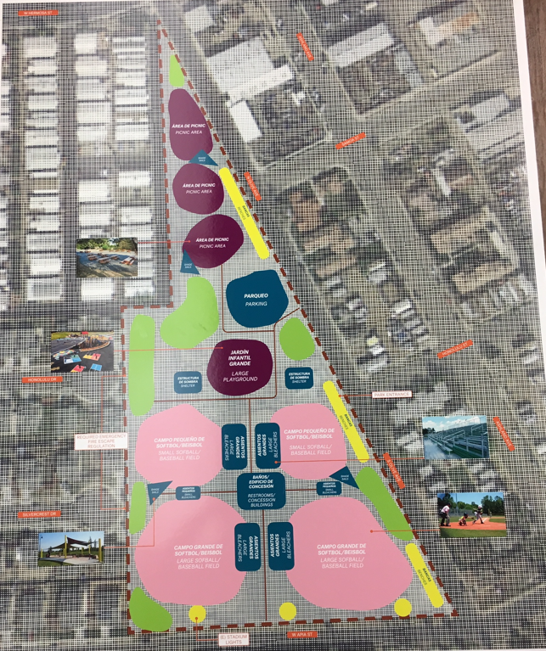
Original Design

Slide 5
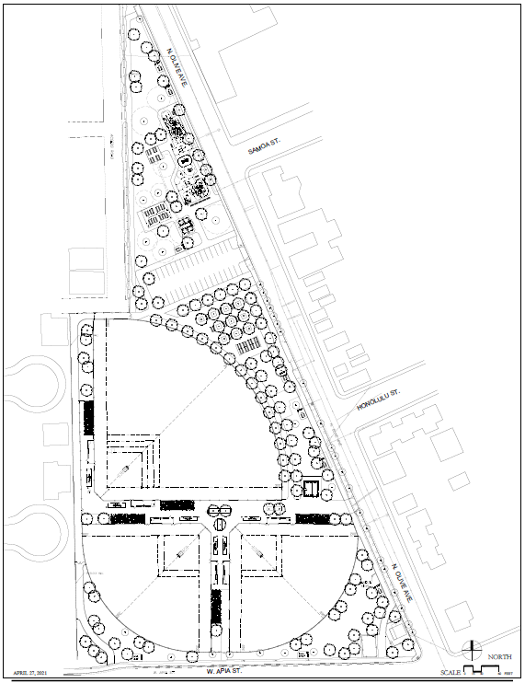
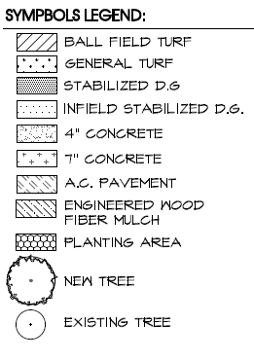
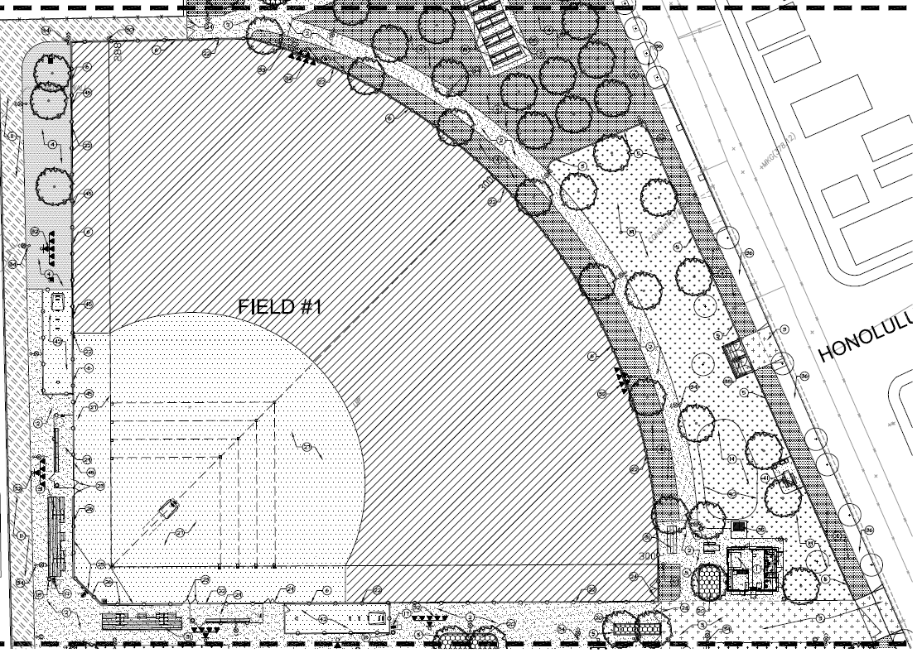
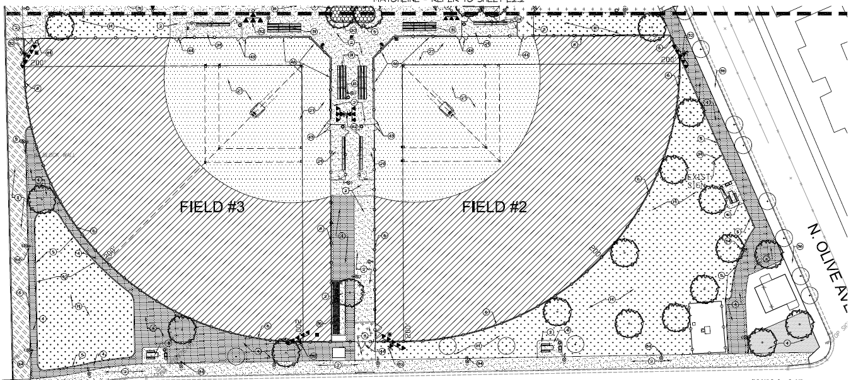
Final Design
Site Amenities
Parking Lot
Restrooms/Concession/Storage Building
4 & 2 Row Spectator Bleachers
Electronic Scoreboard Field #1
Mobile Scoreboards Field #2 & #3
Drought Tolerant Landscaping
Walking Trail
Walkway LED Lights
Security/Surveillance System
Well Irrigation
Trees
Drinking Fountains
Trash Receptables
Picnic Tables
BBQ Grills
Entry Monument
Trash Enclosure
Flagpole

Slide 6
Updated Construction Estimate
Grant Amount: $3,670,437
Landscape Architect $ -235,580
$3,434,857
90% Plans- Estimate
Base Bid: $4,530,000
Alternates: $ 796,000
$5,326,000
Contingencies: $ 665,000
Total $5,991,000
Alternates:
LED Lighting for Field 2 and 3
Play Equipment
Funding Needed: $2,556,143

Slide 7
Additional Funding
Grant (Construction) $3,434,857
Construction Estimate $5,987,000
Funding Needed $2,552,143
Additional Grants
ARPA: $250,000
Parks per Capita: $ 80,000
Additional Grants:$330,000
Application to be submitted
Clean California Local Grant Program $5,000,000 Max Available per application
Community Sponsors
Vita-Pakt Citrus Products Co.
City General Fund
Bond Financing

