Slide 1
FISCAL YEAR 2021-2022 STREET PROJECTS
STUDY SESSION

Slide 2
AGENDA ITEM
OVERVIEW
OVERVIEW OF THE STREET IMPROVEMENT PROGRAM (SIP)
ACTION
ACTION ITEMS:
Consider Approval of Seal and Cape Seal Projects
Consider Approval of Linda Vista Rehabilitation Project
Consider Approval of Hermosa Phase II Rehabilitation Project

Slide 3
FUNDING SOURCES
Fund No. Fund Description
200 Street Improvement Fund
261 Gas Tax Fund
263 Gas Tax-Transportation
265 Gas Tax-Surface Trans. Highway Funds (STP Hwy)
266 Local transportation Fund (LTF)- Article 8 Streets & Roads
Fund No. Project Specific Funding
263 Measure R-Bike & Pedestrian
260 SB 1 Road Maintenance & Rehab.

Slide 4
CATEGORIES
SEALS: application of a mixture of water, asphalt emulsion, aggregate (very small crushed rock), and additives to an existing asphalt pavement surface
TYPE I: Low traffic areas like parking lots
TYPE II: Moderate-Heavy traffic areas like residential streets
TYPE III: Heavy traffic areas like arterial & collector streets
RUBBERIZED CAPE SEALS: application of a rubber coated chip followed by the application of slurry. The chip serves to seal and bond the cracks in the existing pavement.
REHABILITATION: work consisting of structural enhancements that extend the service life of an existing pavement and/or improve its structural capacity. Rehabilitation techniques include restoration treatments and/or structural overlays.

Slide 5
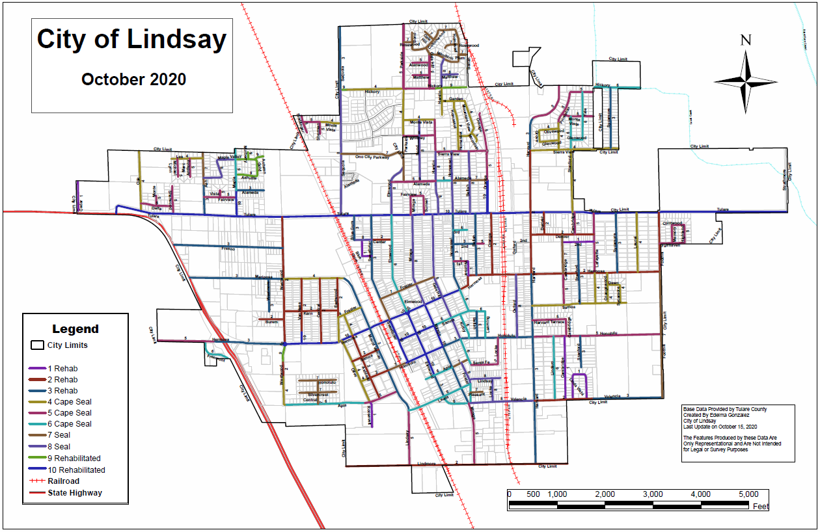
STREET NETWORK CATEGORY

Slide 6
SCORING CRITERIA
10- Rehabilitated – 2 years to Present
9- Rehabilitated – 3 years to 4 years
8- Slurry Seal Treatment – 5 years to 7 years
7- Slurry Seal Treatment – 7 years to 8 years

Slide 7
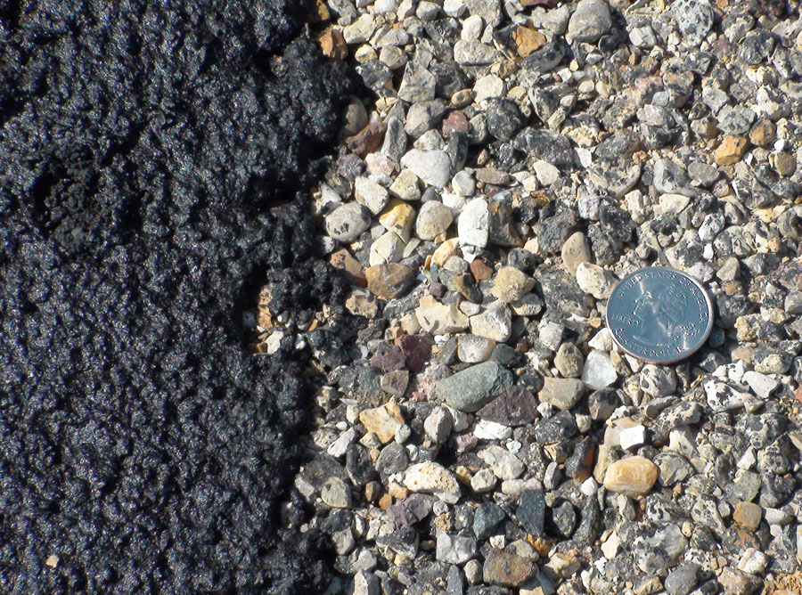
SCORING CRITERIA
6- Cape Seal Treatment – Oil has deteriorated by 25%
5- Cape Seal Treatment – Oil has deteriorated by 50% w/ minor cracking
4- Cape Seal Treatment – Oil has deteriorated by 50% w/ major cracking

Slide 8
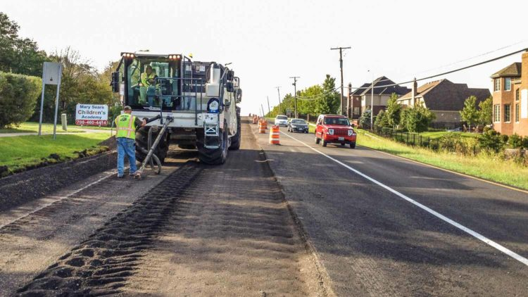
SCORING CRITERIA
3- Rehabilitation Treatment – 25% sub-base failure
2- Rehabilitation Treatment – 50% sub-base failure
1- Rehabilitation Treatment – Complete sub-base failure or no base structure

Slide 9
Keep in mind…
Estimates include:
Sidewalk
Curb & Gutter
Trees
Driveways: Alleys, Residential, Commercial
Cross-gutter
Curb Returns (ADA compliance)
Utilities: Manholes’ and Valves’ Grade Adjusting
Utilities: Water, Sewer & Storm Services

Slide 10
AGENDA ITEM 9.2 A
ACTION ITEMS:
A. Consider Approval of Seals and Cape Seal Projects
B. Consider Approval of Linda Vista Rehabilitation Project
C. Consider Approval of Hermosa Phase II Rehabilitation Project
Consider Approval of Seals and Cape Seal Projects

Slide 11
SLURRY SEALS
CATEGORY 7& 8
Location | Estimated Cost
Parkside Ave | $9,000
Bond Way | $22,000
Maple Valley Subdivision | $23,000
Pelous Ranch Phase 1 | $25,000
Locke Ave | $25,500
Alameda St | $26,000
Foster Ave | $27,000
Oxford Ave | $28,000
Lindsay St | $30,000
Elmwood Ave | $33,000
Sequoia Ave | $34,000
Valencia Ave | $37,500
TOTAL | $320,000
RECOMMENDED BUDGET: $320,000
FISCAL IMPACT: 265 fund

Slide 12
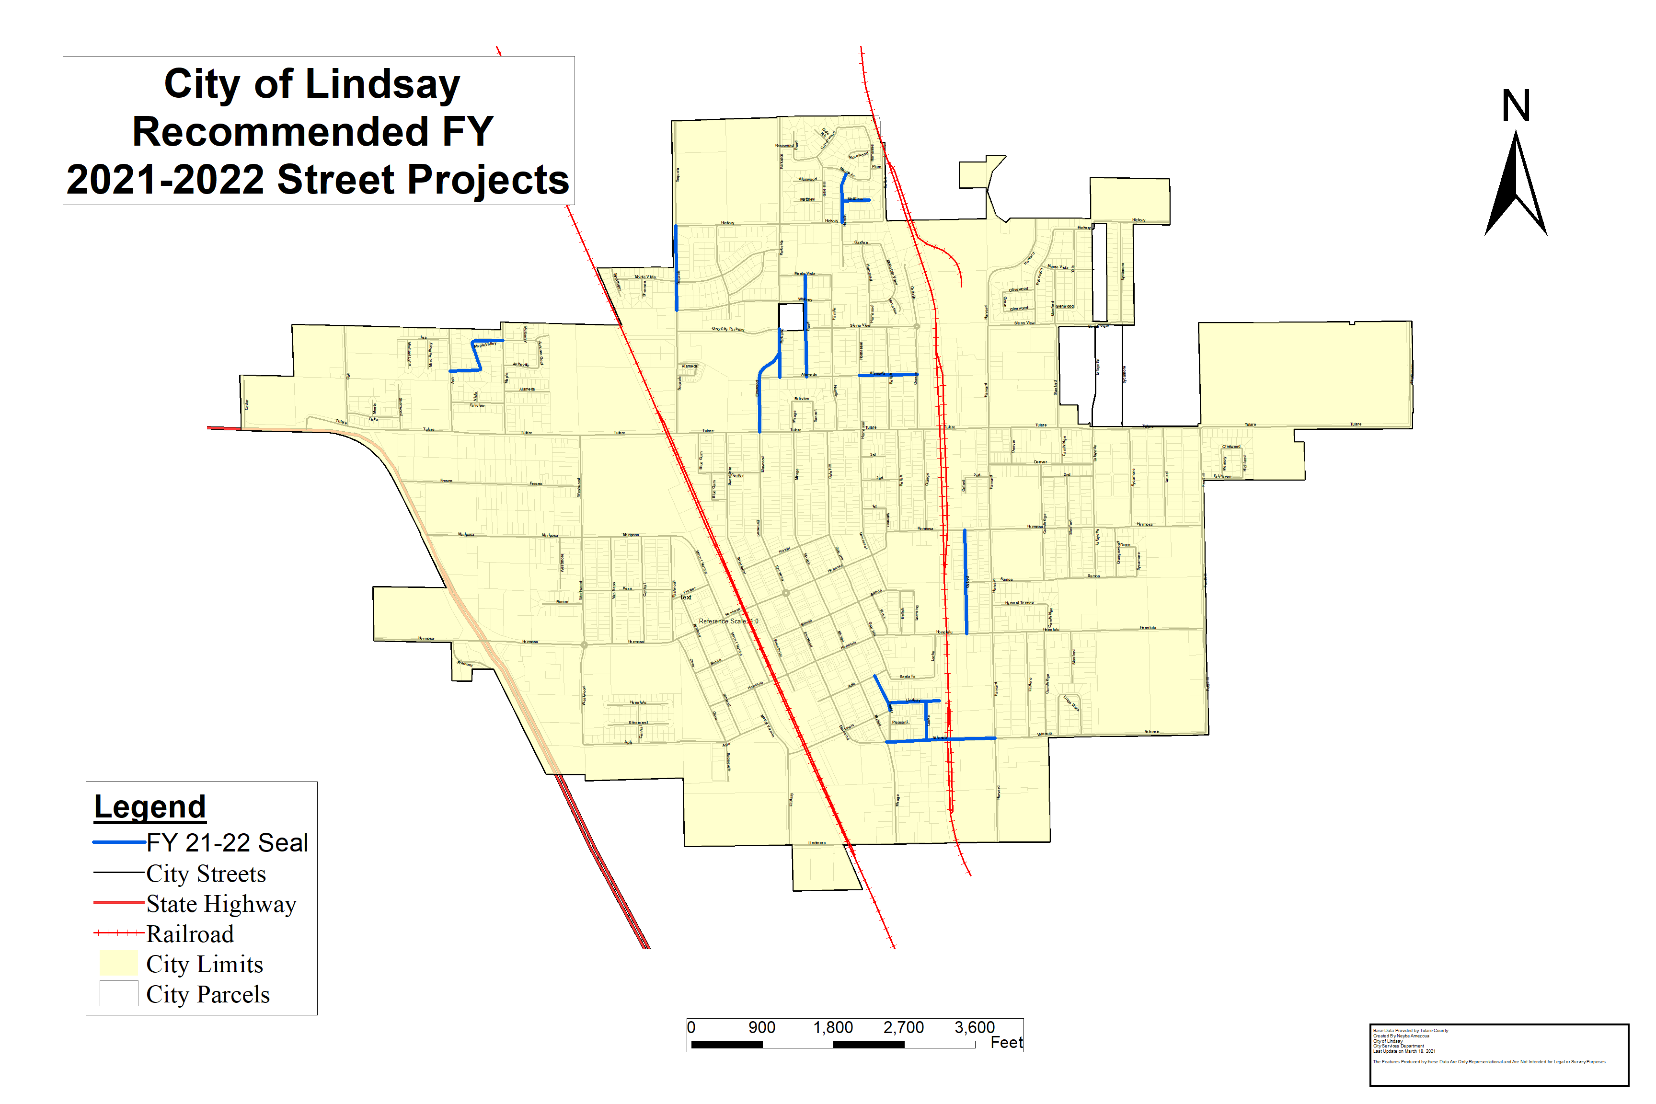
SLURRY SEALS

Slide 13
CAPE SEALS
Location | Estimated Cost
Princeton Ave | $36,000
Sycamore/Dawn | $38,100
Orangewood Ave | $40,000
Lafayette Ave | $40,000
Olivewood/Grove/Glenwood Loop | $57,000
Stanford Ave | $69,000
Laurel Ave | $91,000
Mariposa St | $100,000
Samoa St | $102,000
Sierra View St | $111,000
TOTAL | $684,100
CATEGORY 4
RECOMMENDED BUDGET: $684,100
FISCAL IMPACT : $304,000 - 263 fund
$380,100 - 265 fund

Slide 14
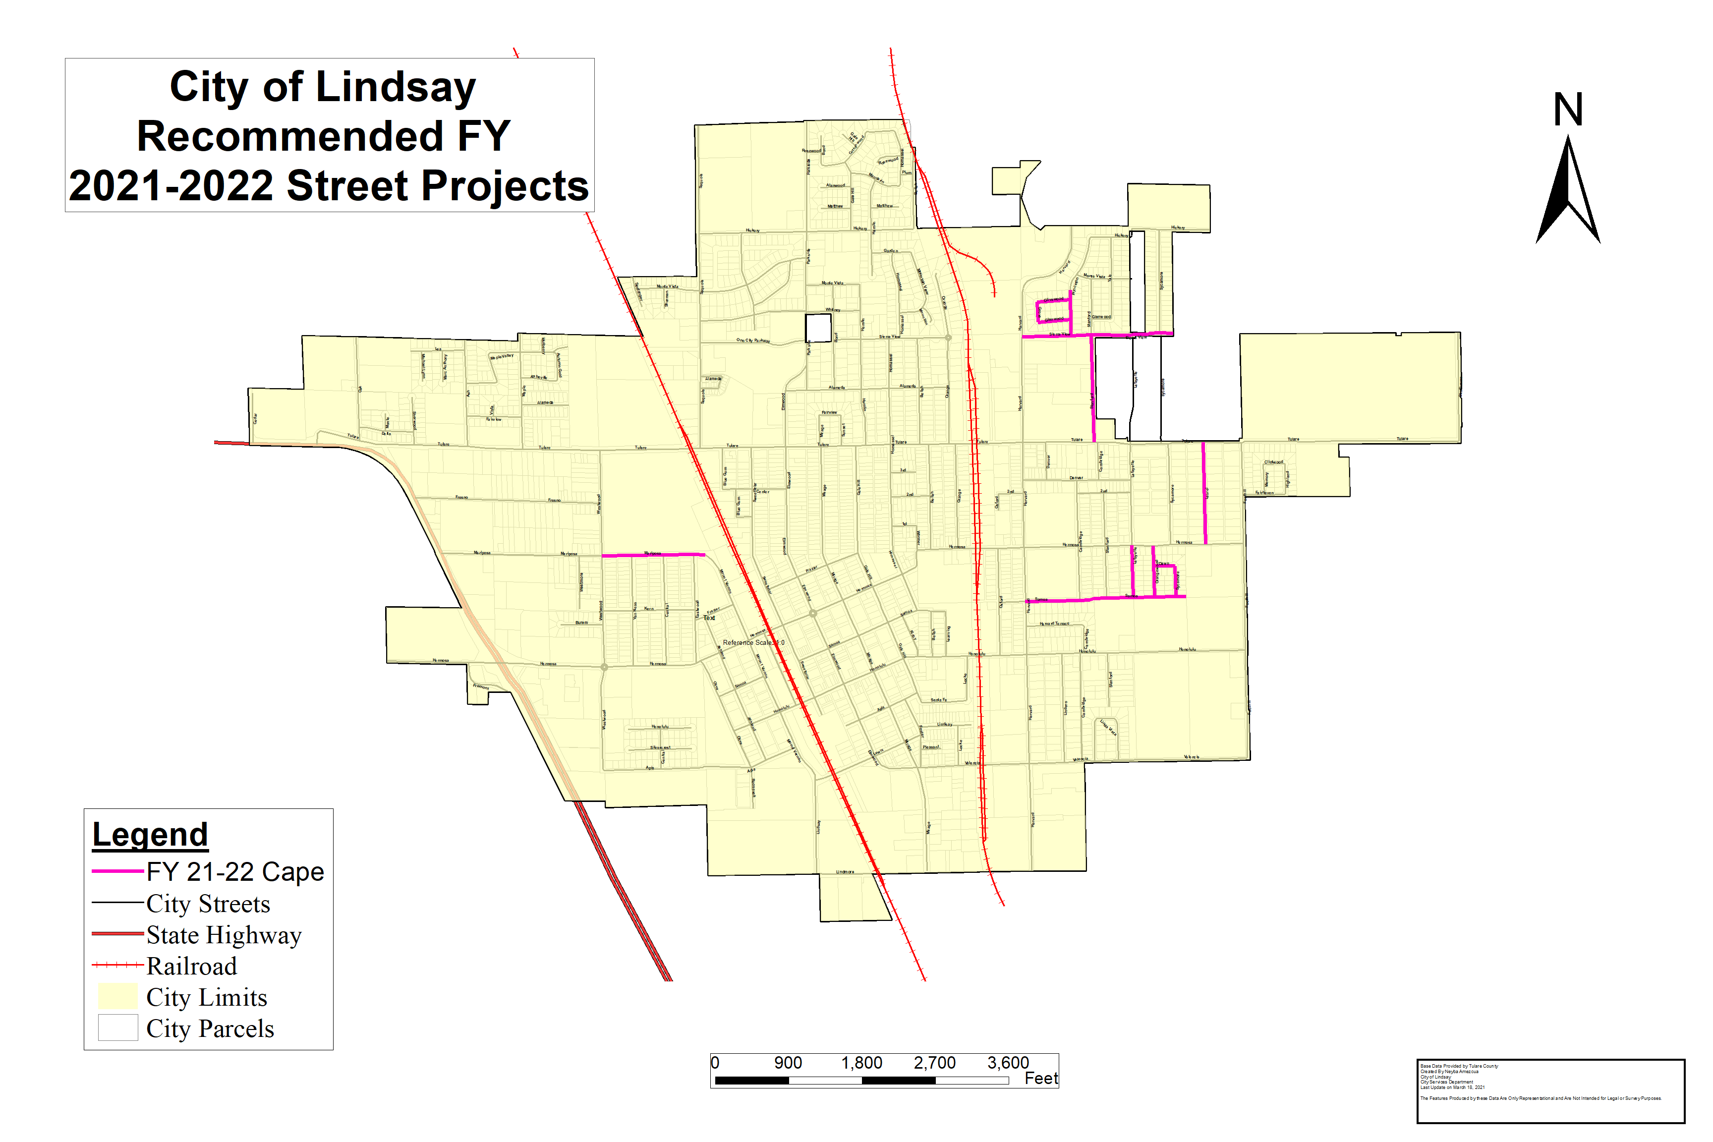
CAPE SEALS

Slide 15
ACTION
A. Consider Approval of Seals and Cape Seal Projects

Slide 16
AGENDA ITEM 9.2 B
Consider Approval of Linda Vista Rehabilitation Project

Slide 17
LINDA VISTA SURVEY RESULTS
SURVEY
MAILED LETTERS (SPANISH & ENGLISH)
Deadline returned by or Postmarked by April 30, 2021
HOSTED TWO NEIGHBORHOOD MEETINGS ON APRIL 29, 2021
12:30 pm & 5:30 pm
CONCEPT LAYOUT

Slide 18
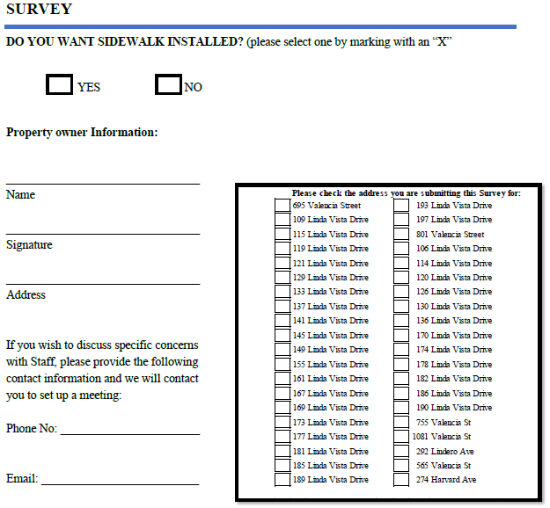
LINDA VISTA SURVEY RESULTS
RESULTS OF SURVEY
TOTAL OF 40 PROPERTY OWNERS
24 YES
14 NOES
2 RETURNED LETTERS
(10 LETTERS OUT OF THE 14 NOES WERE NO RESPONSES)
LETTER INSTRUCTIONS:
YES: I WANT SIDEWALKS
NO: I DO NOT WANT SIDEWALKS
NO RESPOSE: WILL BE CONSIDER AS A NO
Per COL Municipal Code 12.28.10 Sidewalks Construction: “At such time as two-thirds of all the property owners in any given block on one or both sides of any given city street or right-of-way in the city…agree to the installation of sidewalks upon such street, it shall be mandatory that sidewalks be installed for the entire block of the city street or right-of-way…”. Two-thirds are represented by 27 properties; however, Council has full discretion of how to proceed with this project.

Slide 19
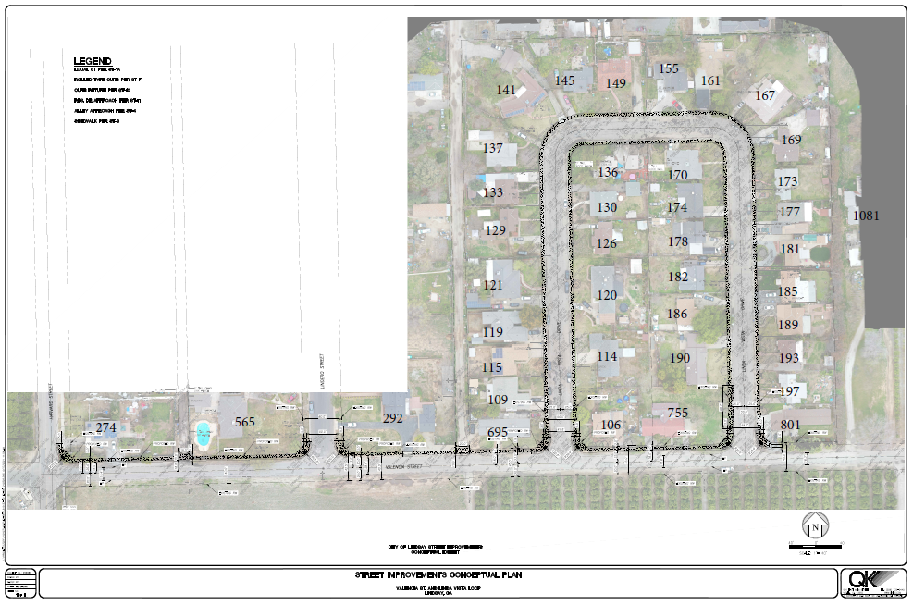
Concept Layout
HARVARD AVE
LINDERO AVE
HARVARD ST

Slide 20
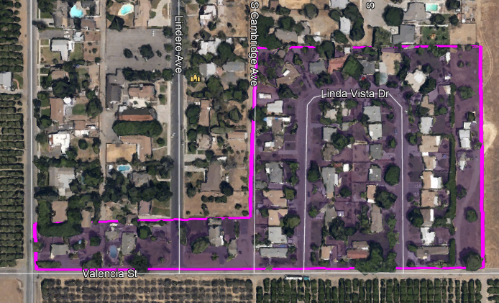
LINDA VISTA OPTIONS

Slide 21
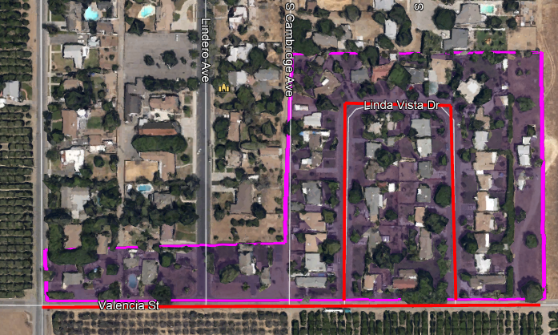
LINDA VISTA OPTION 1
Create pedestrian connectivity from Linda Vista Drive to Harvard St.
Budget includes:
New curb, gutter, & sidewalks
Drive approaches
Fences/mailboxes/landscaping relocations
Street rehabilitation on Valencia from Harvard to Linda Vista and the Linda Vista Loop.
Storm Drain System
ESTIMATE: $1,143,000
FISCAL IMPACT: $679,000 - 200 Fund
$464,000 – Measure R Funds

Slide 22
LINDA VISTA OPTION 2
NO SIDEWALKS
Budget includes:
New curb & gutter
drive approaches
Mailboxes with some MINOR landscaping relocations
Street rehabilitation on Valencia from Harvard to Linda Vista and the Linda Vista Loop.
Storm Drain System
ESTIMATE: $901,147 FISCAL IMPACT: 200 Fund

Slide 23
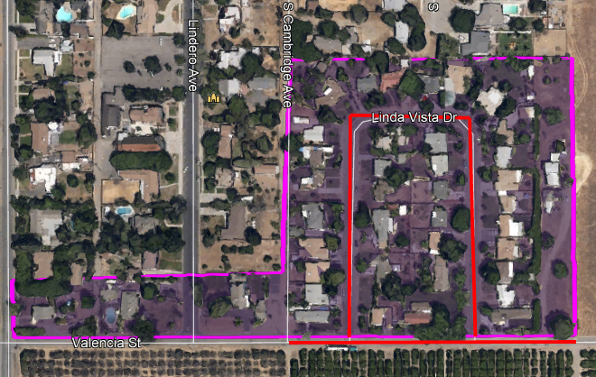
LINDA VISTA OPTION 3
FOCUS ON LINDA VISTA LOOP
NO SIDEWALKS
Budget includes
New curb & gutter
Drive approaches
Mailboxes with some MINOR landscaping relocations
Street rehabilitation on Linda Vista Loop & transition paving on Valencia St.
Storm Drain System
ESTIMATE: $814,401 FISCAL IMPACT: 200 Fund

Slide 24
ACTION
B. Consider Approval of Linda Vista Rehabilitation Project
Option 1 $1,143,000 ($679K-200 Fund $464K- MR)
Option 2 $ 901,147 (200 Fund)
Option 3 $ 814,401 (200 Fund)

Slide 25
AGENDA ITEM 9.2 C
Consider Approval of Hermosa Phase II Rehabilitation Project

Slide 26
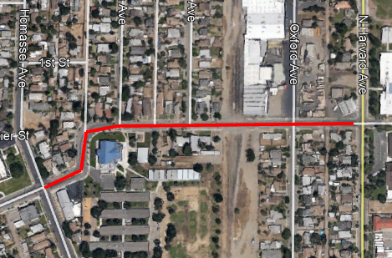
HERMOSA PHASE II
Hermosa Phase 1 FY 2020-2021 Budget $285,000

Slide 27
HERMOSA PHASE II
ESTIMATED COST
$490,000
FISCAL IMPACT: $200,000 - 261 Fund
$290,000 - 263 Fund

Slide 28
ACTION
C. Consider Approval of Hermosa Phase II Rehabilitation Project

